Slide 1
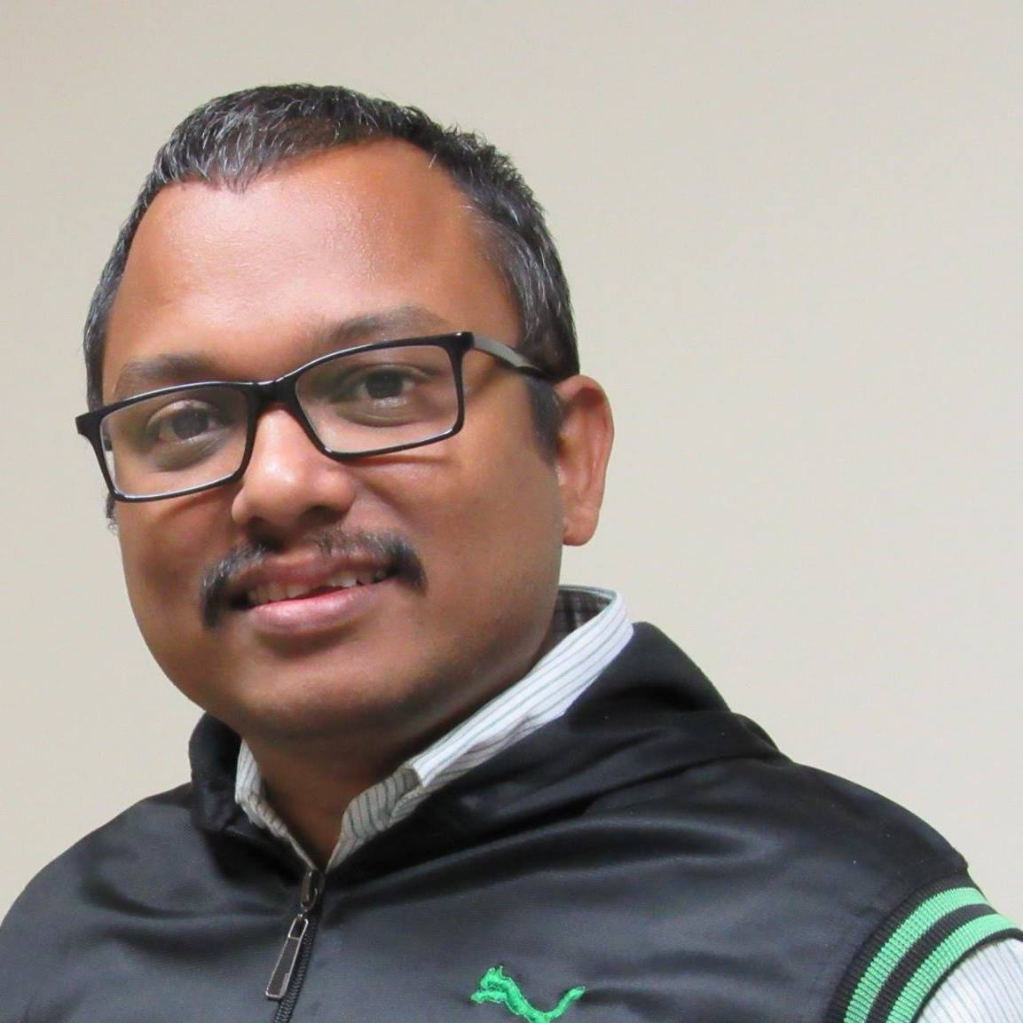
Containers in Azure
#GlobalAzure2022
Wriju Ghosh,
Cloud Solution Architect
@wrijugh

Slide 2
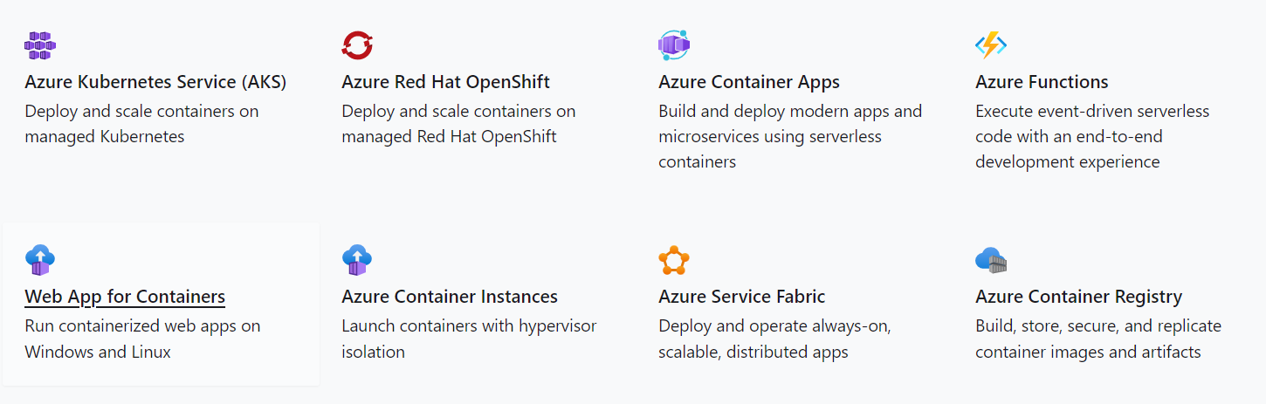
Hosting Containers in Azure

Slide 3

Resources
wrijugh.github.io/TechTalks

